Slide 1



Analysis of RESEARCH Papers Written About COVID-19 Based on Text Content
Vamshi Jaligama
Abhishek raj Sampath
Lakshmi sudha Aluru

Slide 2
Contents:
Impact And Text Analysis on Papers Published On Covid Data. Why?
Dataset
Libraries used
outcome

Slide 3
Impact And Text Analysis on Papers Published On Covid Data. Why?
it is difficult for health professionals to keep up with new information on the virus. By using clustering for labelling in combination with dimensionality reduction for visualization, the collection of literature can be represented by a scatter plot. On this plot, publications of highly similar topic will share a label and will be plotted near each other.
Hence, The main goal of our project is to perform text , impact and exploratory analysis on papers published on covid data by recognizing and categorizing the content of research papers by evaluating and clustering the datasets accordingly with removal of the frequent words based on this we can decide the content and concept inside the papers and sort them into high and low impact papers by linearizing the data.

Slide 4
Dataset: Research papers published related to covid-19.
Title
license
abstract
publish_time
authors
journal
pdf_json_files
release_year
url
ID’s(pmcid)

Slide 5
Libraries used:
numpy
pandas
nltk
os
pickle

Slide 6
Contd….
Datetime
String
multiprocess
Gc

Slide 7
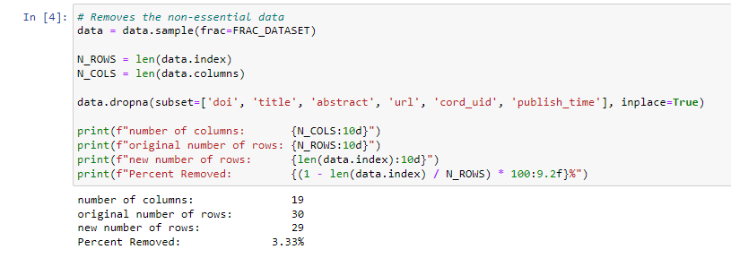
Data cleaning
The process of finding incorrect, incomplete, inaccurate, irrelevant, or missing data and then updating, replacing, or removing it as needed is known as data cleaning. Data cleaning is regarded as a fundamental component of data science.
Our first step was to drop null vales from the dataset which we did using ‘dropna’.

Slide 8
Good paper impact data
score
readers_count
posts
accounts

Slide 9
Textual Analysis
Remove non-essential words (what, is, a)
Turn each remaining word into its root (walking -> walk)
Unsupervised learning on each title
Apply the machine learning model to turn each sentence to a list of 100 numbers

Slide 10
Dataset clusturing
Using Principle Component Analysis (PCA) to turn 100 columns of data into 3.
Using K-nearest neighbors to group papers based on the closest Euclidan distance.

Slide 11
Vectorization
Extracts common keywords from each cluster.
removing a list of keywords common to all.

Slide 12
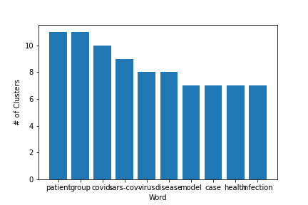
Outcome:
From these clusters, I hope to generate new insights about how papers gain popularity, especially outside of scientific literature. The one unique thing that this clustering incorporates is each paper's popularity in their respective fields. AI techniques to generate new insights in support of the ongoing fight against this infectious disease. There is a growing urgency for these approaches because of the rapid acceleration in new coronavirus literature, making it difficult for the medical research community to keep up. This allows the worldwide AI research community the opportunity to apply text and data mining approaches to find answers to questions within, and connect insights across, this content in support of the ongoing COVID-19 response efforts worldwide. There is a growing urgency for these approaches because of the rapid increase in coronavirus literature, making it difficult for the medical community to keep up.

Slide 13

Thank you

